Slide 1
RADV Risk Adjustment Data Validation Tool
FHIRed UP
Augusto Burgos aburgos3@gatech.edu Spiro Ganas spiroganas@gmail.com Anja Guillory anjag1993@gmail.com Jamie Richgels jrichgels3@gatech.edu Daniel Stoneburner dstoneburner3@gatech.edu Tala Suidan tmsuidan@gatech.edu

Slide 2
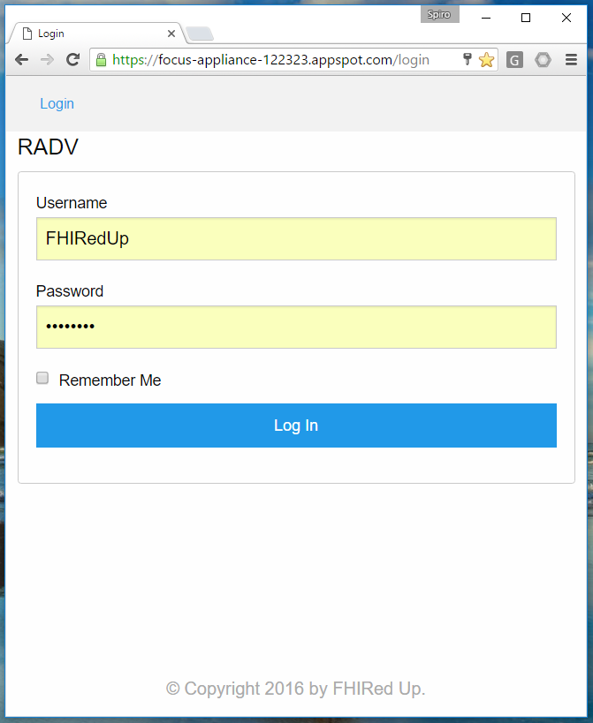
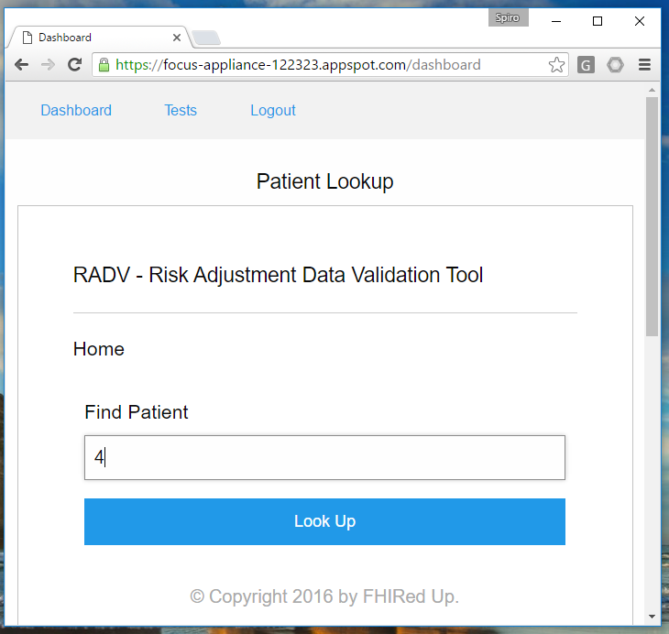

Slide 3
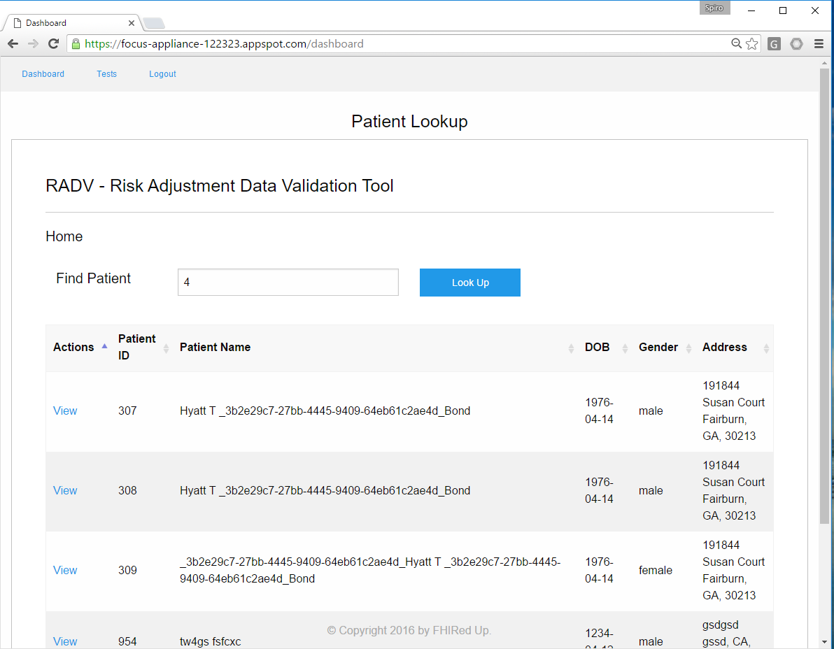

Slide 4
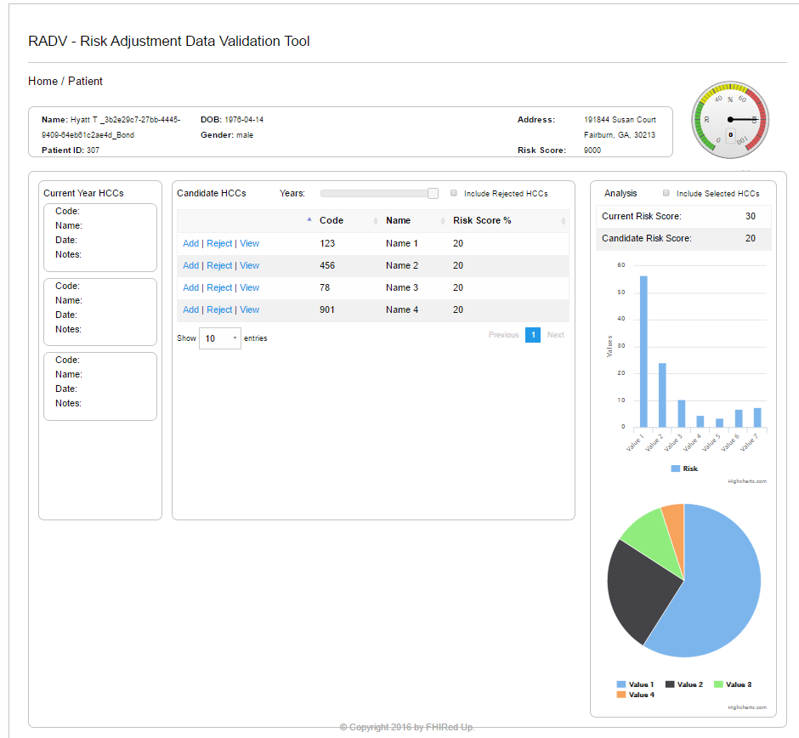

Slide 5
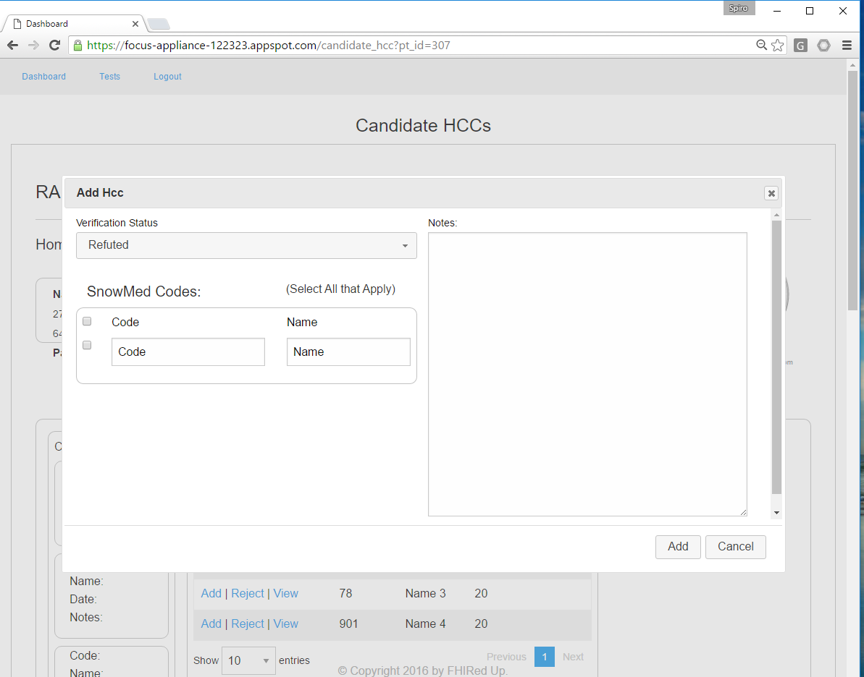

Slide 6
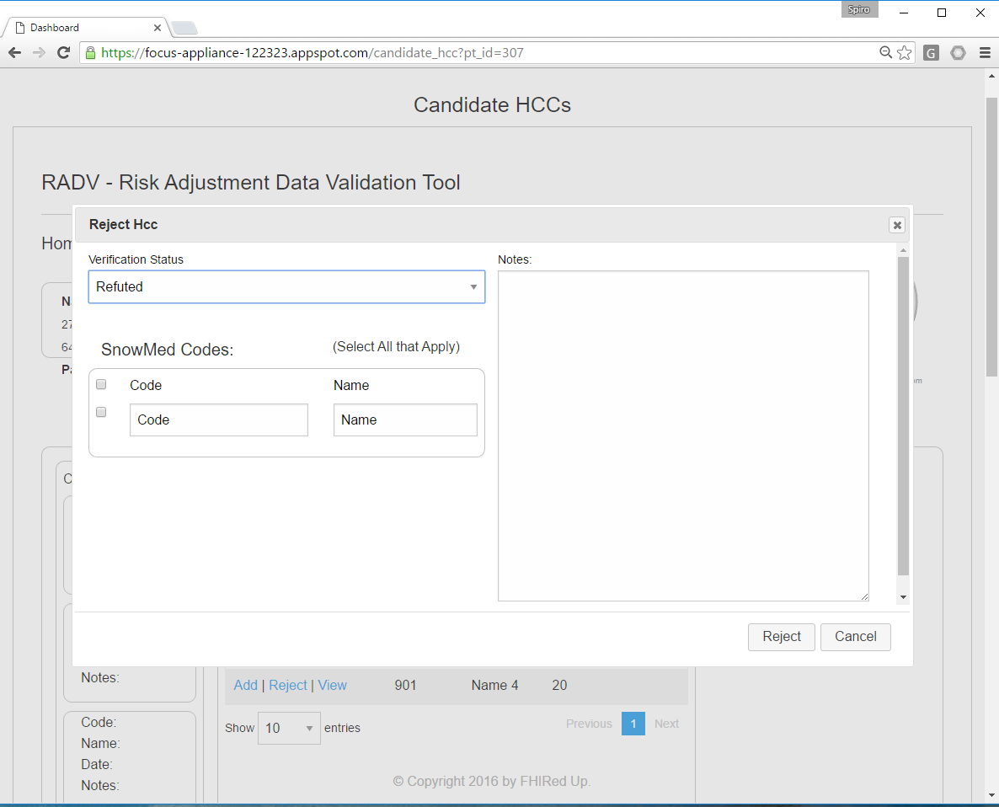

Slide 7
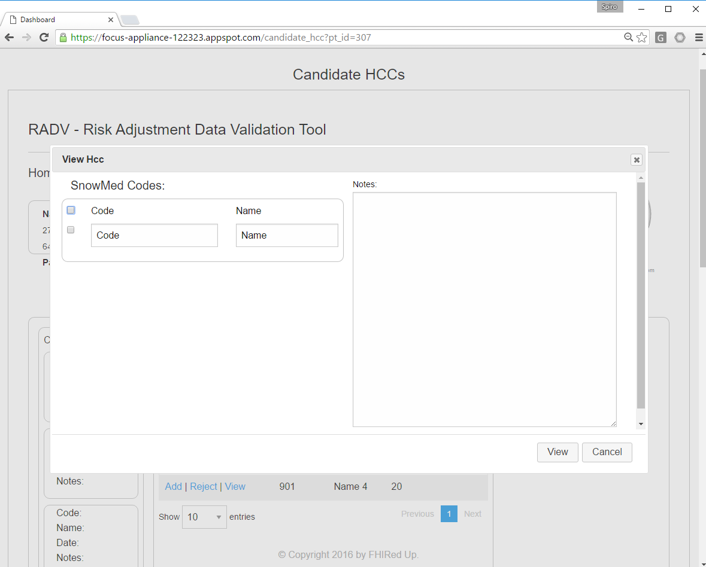

Slide 8
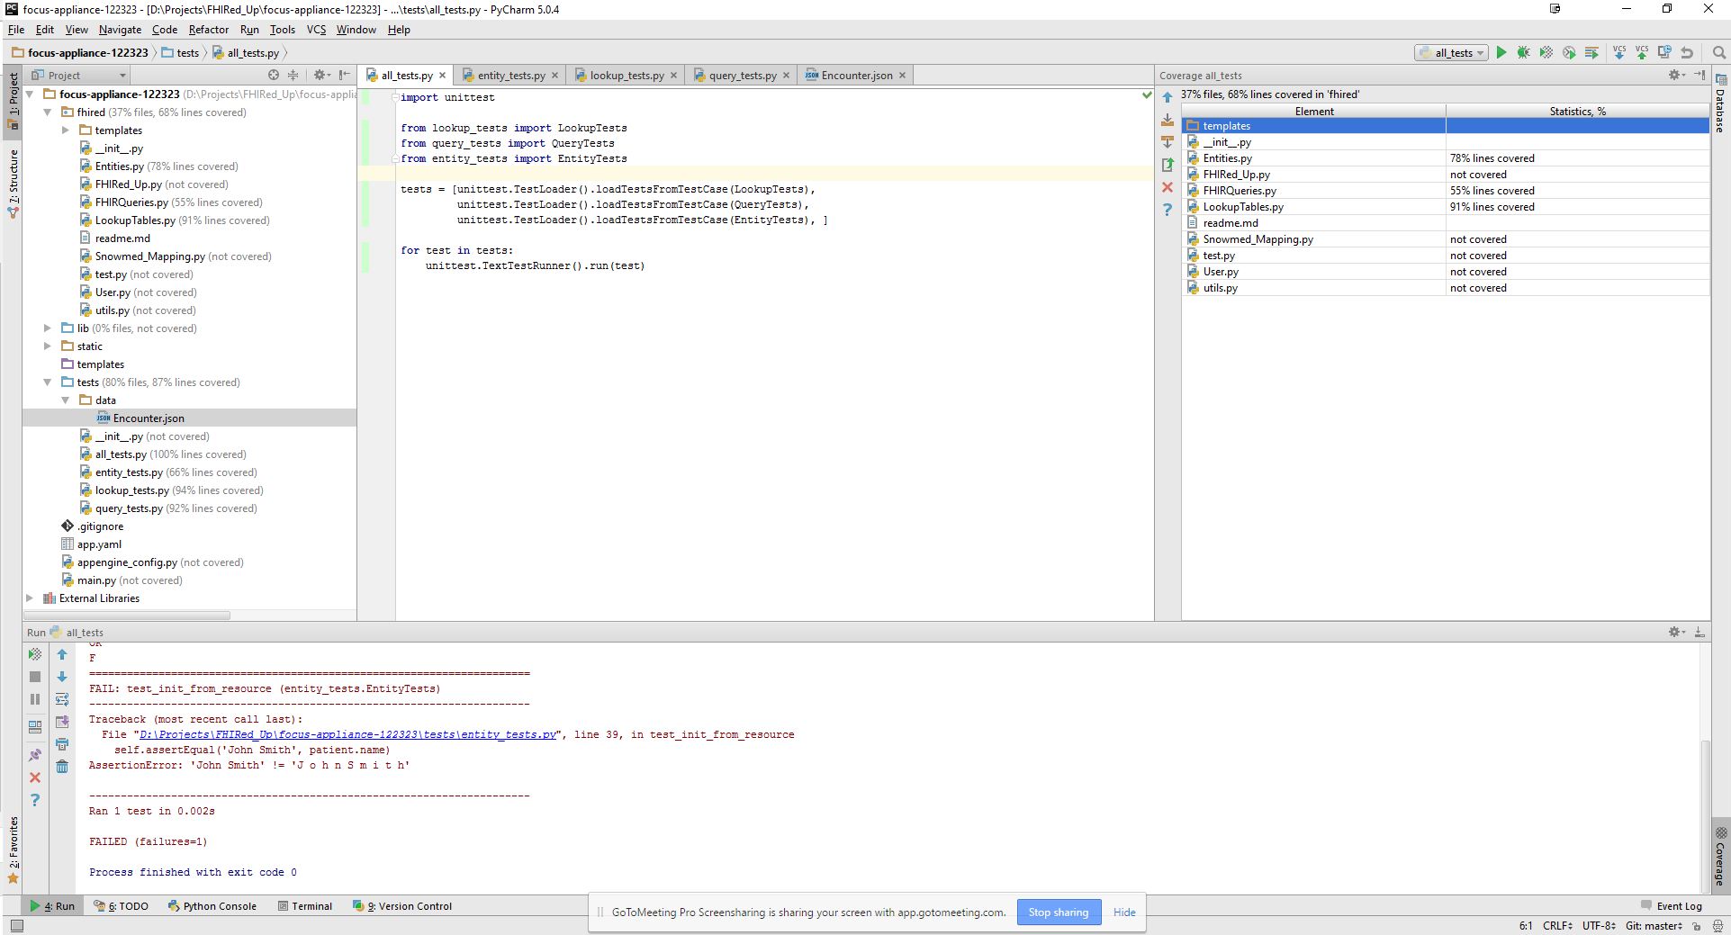
QA Testing

Slide 9
Updated Gantt Chart
* All team members involved † - Developers and testers involved ‡ - Business Analysts involved
Milestones and tasks in purple and dark blue are complete. Remainder are in progress or in the future
Notes:
Must Update the Image

Slide 10
Concerns & Other Issues

Slide 11
References

